Slide 1


Slide 2
1. An engineer who is studying the tensile strength of a steel alloy intended for use in golf club shafts knows that tensile strength is approximately normally distributed with standard deviation 50 psi. A random sample of 16 specimens has a mean tensile strength of 3450 psi. Test the hypothesis that mean strength is 3500 psi. Use α = 0.01.

Slide 3




2. Suppose you want to test the claim that
Given a sample size of and a level of significance of
When should you reject ?

Slide 4
3. Human oral normal body temperature is believed to be 98.6°F, but there is evidence that it actually should be 98.2°F [Mackowiak, Wasserman, Steven and Levine, JAMA (1992, Vol. 268(12), pp. 1578–1580)]. From a sample of 52 healthy adults, the mean oral temperature was 98.285 with a standard deviation of 0.625 degrees.
(a) What are the null and alternative hypotheses?
(b) Test the null hypothesis at α = 0.05.

Slide 5
4. Complete the missing items in the following computer output.
Test Hypotheses of p = 0,4 and not p = 0,4
X N Sample p 95% CI Z-value P-value
98 275 ? (0,299759;0,412968) ? ?

Slide 6
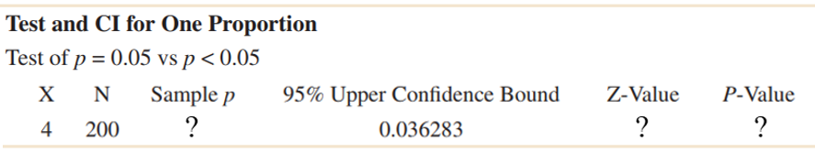
5. Complete the missing items in the following computer output.

